Slide 1

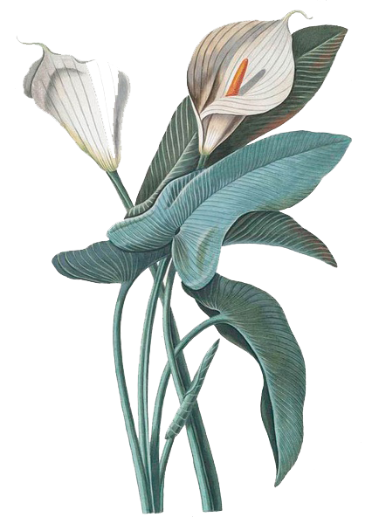
Image Style Transfer Using Convolutional Neural Networks
Computer Science and Technology of Shandong University of Science and Technology Level 2017
presenter：Xin Xue Ning

Slide 2
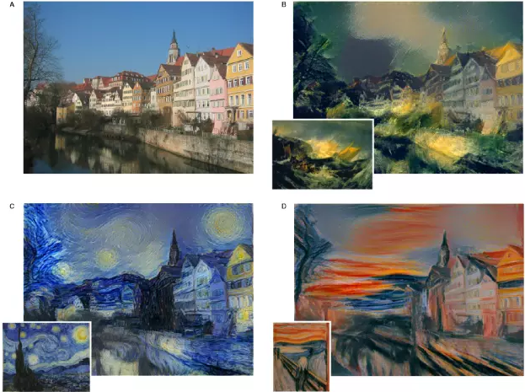
Topic background
01
Social needs
Modern people have a stronger and stronger social networking on the Internet, and have a higher demand for specific applications. People hope to make their favorite pictures into various styles while enjoying the pictures they have taken。
02
Convenient and fast
Manual drawing is time-consuming and laborious. People hope to easily turn the subsequent pictures into the desired style without mastering professional drawing skills.
03
Broad application fields
Artistic aesthetic effect / transplantation to app;
Map generation from satellite photos (map drawing);
Generating a color image from a black-and-white image;
Generate font
Generate real photos from hand-painted pictures (portrait drawing of suspects);

Slide 3
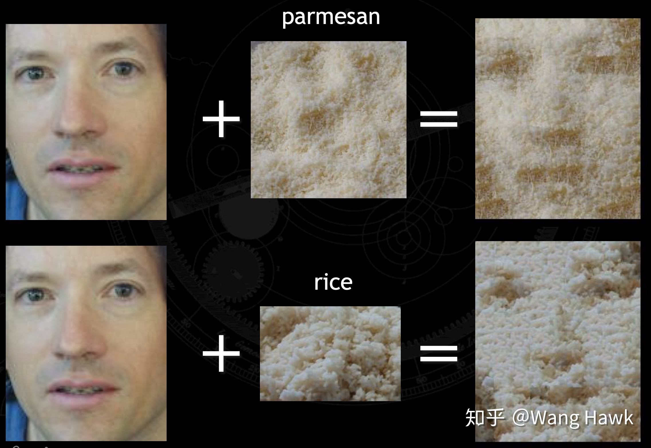
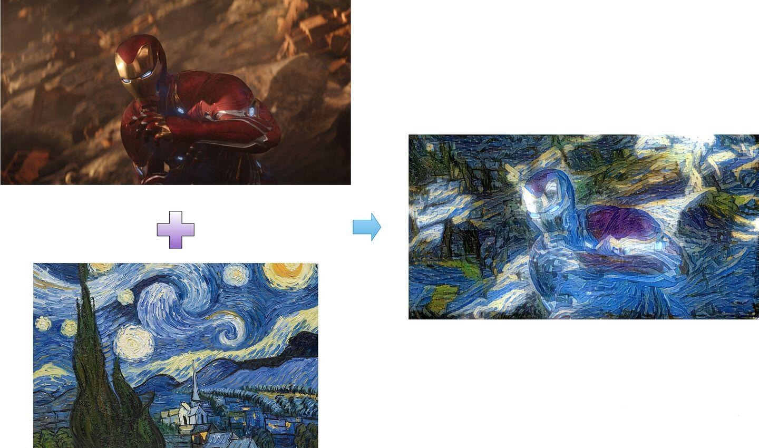
research meaning
Traditional picture style migration
The traditional image style transfer method is nonparametric, which mainly hopes to achieve the expected effect through texture synthesis and physical model rendering. Therefore, traditional methods can only extract the features at the bottom of the image, so they can not get high-level abstract features. Therefore, although processing the image with simple structure can achieve the expected effect, when the color and texture of the processed image are complex, the final synthetic image effect is not very ideal. And most of the modeling is done manually, which is time-consuming and laborious. At the same time, the number of image styles generated is also very limited, so the research progress is very slow.
Image style transfer based on convolutional neural network
In recent years, with the wide application of deep neural network in other visual perception fields, such as object and face recognition, it also has a good performance in the field of style migration. Neural network has good feature extraction ability and can extract rich semantic information, which is the basis of style migration. Therefore, compared with the traditional method of picture style migration, the method of picture style migration using the neural network extracts more accurate picture features, generates more pictures with the expected effect, and has lower time cost and more convenience.

Slide 4
Image style transfer method based on convolutional neural network
Style migration based on maximum mean difference
01
01
Style Migration Based on Generated Model
Model-based iteration
Image-based Iteration
Style Migration Based on Markov Random Field
02
Style Migration Based on Image Reconfiguration Decoder
02
Style migration based on depth image analogy
03

Slide 5
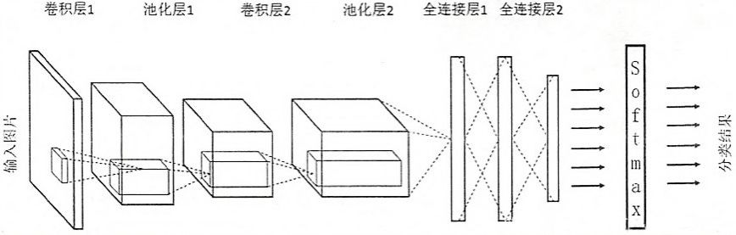
Convolutional neural network
01
Introducing Convolution Neural Network
Constitutional Neural Networks (CNN) is a deep learning method specially designed for image classification and recognition based on multilayer neural networks.
Neural network has good feature extraction ability and can extract rich semantic information, which is the basis of style migration.
一A convolution neural network consists mainly of the following five structures
02
Convolutional neural network structure
convolution layer, pooling layer and full connection layer

Slide 6
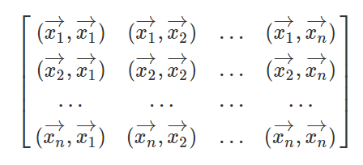
Explanation of key proper nouns
Image style transfer
01
02
Gram matrix
Gram matrix is a symmetric matrix about the inner product of a set of vectors. It can reflect the relationship between vectors.
Add the style features of another picture based on the content features of one picture to generate a new picture.
03
04
Content features
Content features: the specific elements in the picture, and the activation value of the image on a certain layer after input to CNN.
How to extract: through continuous convolution operation, constantly update the parameter value of the network, and then evaluate it through the loss function.
Style characteristics
Style features: the style of drawing picture elements, the commonalities between various contents, and the correlation between the activation values of images at a certain layer of CNN network.
How to extract: Gram matrix can extract the hidden relationship between image features.

Slide 7
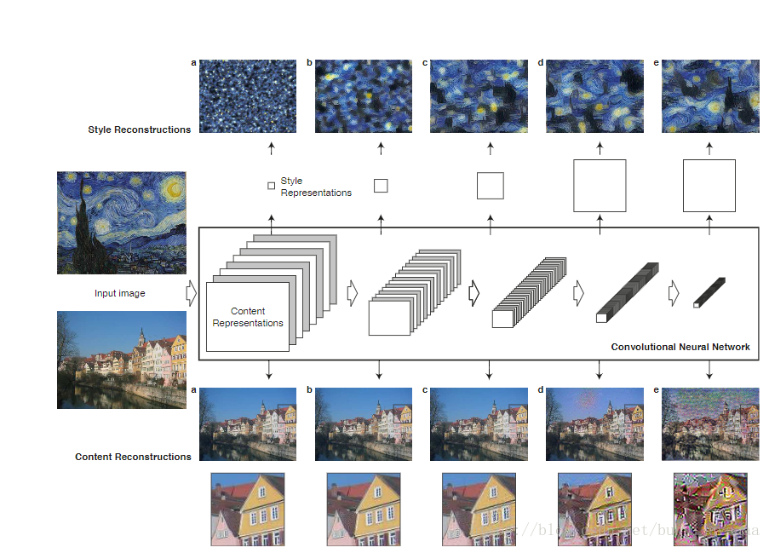
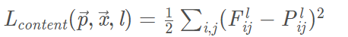
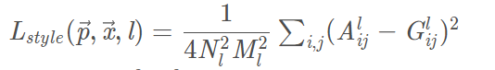
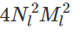
Original picture style migration
Content loss function
Style loss function
Style transfer method
Among them, on the denominator is a normalized term, which aims to prevent the loss of style from being too large compared with the loss of content.
The original image style transfer uses a total loss function to measure whether it successfully combines the content and style of the original image and the style of the image. Then, aiming at the total loss function, the gradient descent method is used to iterate step by step. Because it needs to be optimized step by step in the process of image generation, the speed is very slow.
Total loss function

Slide 8
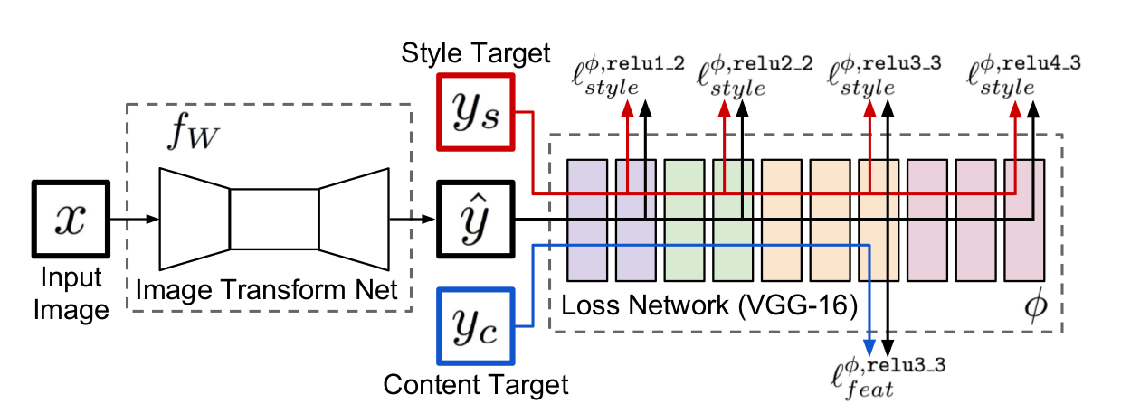
Fast image style migration
Perceived loss network
It is the same as the original picture style migration.
Style transfer method
In convolution model training, the parameters of the network are adjusted by inputting fixed pictures, so as to achieve the purpose of using pictures to train the network. When generating a specific style picture, fix the existing network parameters and adjust the picture, so as to transform the picture to the target style. In the content style conversion, adjust the pixel value of the image to make it close to the content features of the target image output in the convolution network. In the calculation of style features, the Gram matrix is obtained by summing the inner product between the outputs of multiple neurons, and then the average value of the G matrix is obtained by difference to obtain the loss function of style.
Image generation network
Parameters need training to convert content images into migration images

Slide 9
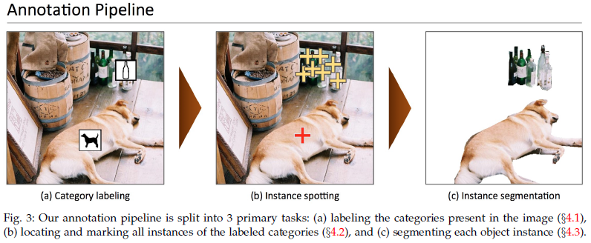
Project realization basis
Django framework:
Django is an open source web application framework written in Python.
Django adopts MVT software design patterns, namely model, view and template. (database, HTML)
Implementation basis
data set
Coco dataset: Coco dataset is a large and rich object detection, segmentation and caption dataset. Coco dataset is the largest dataset with semantic segmentation so far. It provides 80 categories and more than 330000 pictures, of which 200000 are marked. The number of individuals in the whole dataset exceeds 1.5 million.
All coco data sets are used in the project to train the model.
Language: Python
Platform: tensorflow
Frame: Django
Web pages: HTML

Slide 10
Analysis of main modules of the project
SQLite database
UI interface
Loss network
Image generation network: the responsibility of image generation network is to generate an image of a certain style. Its input is an image and its output is also an image. Because the generated image only needs to be calculated once in the network, the speed is much higher than that of the original image style migration.

Slide 11
Project features
It realizes the fast image style migration project that can convert 7 styles
01
02
03
Convolution neural network algorithm
Instance normalization replaces the usual batchnormalization
In recent years, the rapid development of deep convolution neural network provides a powerful computer vision system, which can effectively extract high-level semantic information from natural images.The convolution neural network algorithm for image style migration can make up for the shortcomings of the traditional nonparametric image style migration algorithm, which can not preserve the content features of the target image and make the style migration in line with the content features.
Instance Normalization（IN），A normalization algorithm (IST, Gan, etc.) that is more suitable for scenes with higher requirements for a single pixel.In itself is a very simple algorithm, which is especially suitable for scenes with small batches and considering each pixel separately, because there is no mixed data between batches and channels when calculating normalized statistics. For applications in this scenario, we can consider using in.
Seven pre training models are provided:
wave.ckpt-done 、cubist.ckpt-done、denoised_starry.ckpt-done、
mosaic.ckpt-done、scream.ckpt-done、feathers.ckpt-done.

Slide 12
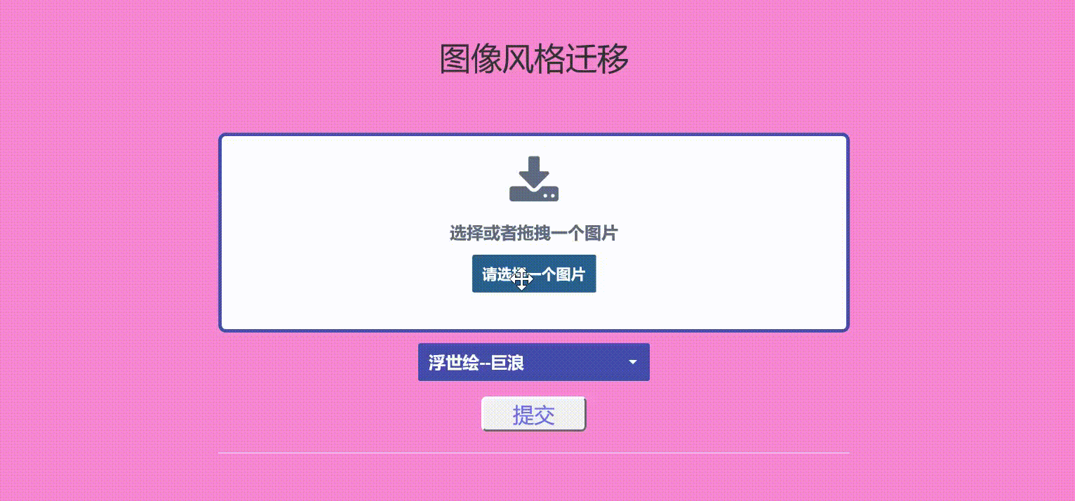
Project display

Slide 13


expectation
expectation
Fast image style transfer method has achieved good results in image style transfer, but at present, on the basis of perceived loss, some scholars have proposed to join Gan (generate confrontation network) to generate more effective images. Therefore, this part can be studied in the later learning process.

